Slide 1
COMP814 – Text Mining Vector Space Model/ Similarity Computations

Slide 2
Reference
Mainly chapter 6 & 7 – Introduction to Information Retrieval – Manning et. al
Etc

Slide 3
What is Vector Space Model and Why?
Representation of a document or a discourse with a data structure.
So as to be able to do operations on it.
Vector of words
Can do vector and other mathematical operations
So that documents can be ranked

Slide 4
How can we retrieve relevant documents from an archive?
Boolean model: all documents matching the query are retrieved
A query consists of search words combined using logical AND and OR operators.
The matching is binary: yes or no
Extreme cases: the list of retrieved documents can be empty, or huge
A ranking of the documents matching a query is required so that more relevant documents is presented first as in a google search.
What are the possibilities for ranking?

Slide 5
Document scoring possibilities
Need a way of assigning a score or weight to a query and document pair
Most obvious is the frequency of the terms.
Ignore the order of occurrence
Bag of Words model
Are all words equally important?
Stop words?
Word inflections
Plurals and singular words?

Slide 6
Vector representation of a corpus
 | d₁ | d₂ | d₃ | …….. | d_{n}
t₁ | w₁₁ | w₁₂ | W₁₃ | …….. | w_{1n}
t₂ | w₂₁ | w₂₂ | W₂₃ | …….. | w_{1n}
. . . . | . . . . | . . . . | . . . . | . . . . | . . . .
t_{m} | w_{m1} | w_{m2} | W_{m3} | …….. | w_{mn}

Slide 7
Vector Space Representation
How many dimensions will the vector have?
Dimension reduction strategies
Stop words
Stemming
Feature selection
Latent Semantic Analysis

Slide 8
Frequency count matrices
Say we are analysing 8 newspaper articles for relevance to National Party
One Hot representation
Vector representing the presence or absence of tokens
 | Doc 1 | Doc 2 | Doc 3 | Doc 4 | Doc 5 | Doc 6 | Doc 7 | Doc 8
John | 15 | 12 | 0 | 0 | 2 | 0 | 0 | 2
Key | 12 | 0 | 4 | 0 | 0 | 0 | 0 | 8
Government | 0 | 0 | 0 | 12 | 3 | 0 | 4 | 6
National | 0 | 0 | 5 | 3 | 0 | 6 | 0 | 0
Party | 4 | 3 | 0 | 0 | 0 | 8 | 7 | 7
English | 0 | 4 | 0 | 1 | 5 | 0 | 0 | 2

Slide 9
Bag of words model (BOW)
Vector representation doesn’t consider the ordering of words in a document
The dog bit the man and The man bit the dog would have same representation
This is called the bag of words model.
We will see later that there are models that recover the positional information
However the BOW model is surprisingly effective in most situations.

Slide 10
Vector Space model: word2vec
Each term t of the dictionary is considered as a dimension
A document d can be represented by the weight of each dictionary term:
V(d) = (w(t1, d), w(t2, d), . . . , w(tn, d))
Sparse matrix for most documents
Question: does this representation allow to compute the similarity between documents ?
Similarity between vectors ?
inner product V(d1).V(d2)
What about the length of a vector ?
Longer documents will be represented with longer vectors (and higher frequencies), but that does not mean they are more important?

Slide 11
Term Frequency Tf
The term frequency tf_{t,d} of term t in document d is defined as the number of times that t occurs in d.
We want to use tf to compute relevance to a query
Raw term frequency is not what we want:
A document with 10 occurrences of the term is more relevant than a document with 1 occurrence of the term.
But not 10 times more relevant.
Relevance does not increase proportionally with term frequency.
Solution: we can normalize it.
We can divide the frequency of the term by the number of words

Slide 12
Document frequency
Frequent terms are less informative than rare terms
Consider a query term that is frequent in the collection (e.g., high, increase, line)
A document containing such a term is more likely to be relevant than a document that doesn’t
But it’s not a sure indicator of relevance.
For frequent terms, we want high positive weights
E.g. for words like high, increase, and line
But lower weights than for rare terms.
We will use document frequency (df) to capture this.

Slide 13
Inverse Document Frequency idf
df_{t} is the document frequency of t, ie. the number of documents that contain t
df_{t} is an inverse measure of the information content of the term t
df_{t} ≤ N, N is the number of documents.
We define the id_{f} (inverse document frequency) of t as
Idf_{t} = log₁₀ (N/df_{t})
Where N is the total number of documents and df_{t} is the document frequency containing t
We use log (N/dft) instead of N/dft to “dampen” the effect
The base is not important, why?

Slide 14
Exercise
Compute the IDF term for the following with log and without log.
Figure out N
Term | Df(t) | IDF without log | IDF with log
National | 1 | 10 000 000
party | 100 | 10 000 0
John | 1 000 | 10 000
Key | 10 000 | 10…..
Government | 100 000
English | 1000 000
the | 10 000 000

Slide 15
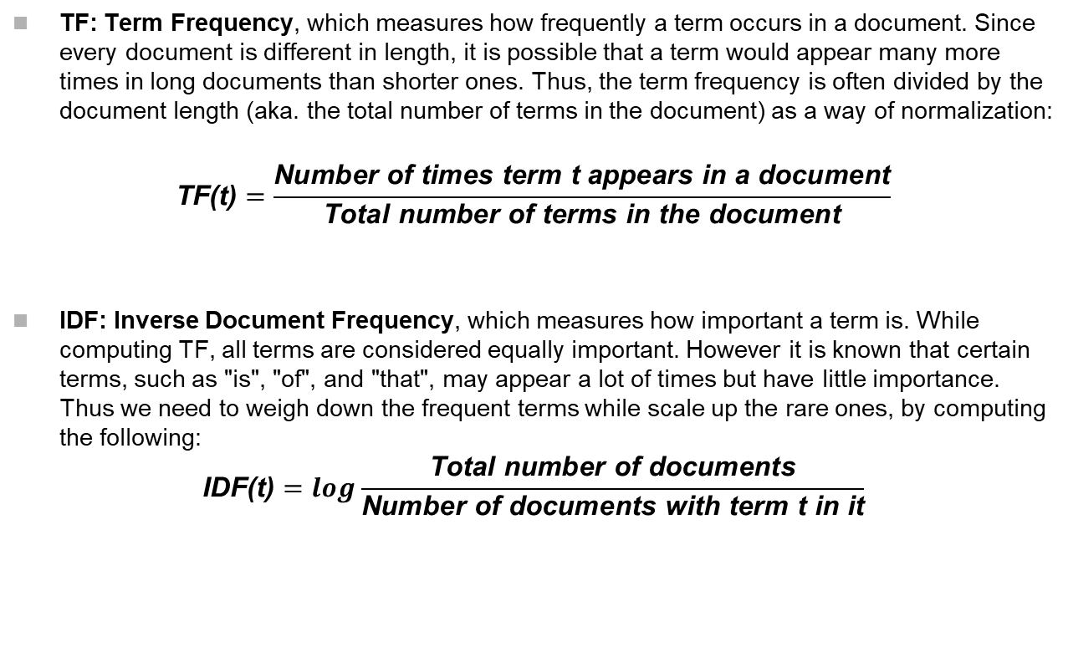
TF-IDF Computation
TF: Term Frequency, which measures how frequently a term occurs in a document. Since every document is different in length, it is possible that a term would appear many more times in long documents than shorter ones. Thus, the term frequency is often divided by the document length (aka. the total number of terms in the document) as a way of normalization:
$$\text{TF}\text{(}\text{t}\text{)}=\frac{\text{Number} \text{of} \text{times} \text{term} \text{t} \text{appears} \text{in} \text{a} \text{document}}{\text{Total} \text{number} \text{of} \text{terms} \text{in} \text{the} \text{document}}$$
IDF: Inverse Document Frequency, which measures how important a term is. While computing TF, all terms are considered equally important. However it is known that certain terms, such as "is", "of", and "that", may appear a lot of times but have little importance. Thus we need to weigh down the frequent terms while scale up the rare ones, by computing the following:
$$\text{IDF}\text{(}\text{t}\text{)}=log\frac{\text{Total} \text{number} \text{of} \text{documents}}{\text{Number} \text{of} \text{documents} \text{with} \text{term} \text{t} \text{in} \text{it}}$$

Slide 16
Tf-idf weighting scheme
The tf‐idf weight of a term is the product of its tf weight and its idf weight.
tf-idf_{t,d} = log(1+ tf_{t,d}) X log(N/df_{t})
tf-idf_{t,d} = tf_{t,d} X log(N/df_{t}) - alternative
Best known weighting scheme in information retrieval
Increases with the number of occurrences within a
document
Increases with the rarity of the term in the collection/corpus

Slide 17
Exercise
Compute the tf-idf weightings for the following 4 terms for the 4 terms in a corpus of 3 documents. Use unnormalized form for the term frequency
Which term would be the best to use as a search term?
 | doc1 | doc2 | doc3
car | 27 | 4 | 24
auto | 3 | 60 | 0
insurance | 0 | 0 | 29
best | 14 | 4 | 17

Slide 18
Similarity Computations
How similar are these?
The dog bit the man.
The man bit the dog.
When the dog bit the man.

Slide 19
Similarity Distance conditions
Let x and y be any two objects in a set and d(x, y) be the distance between x and y.
Conditions
The distance between any two points must be non negative, that is, d(x, y) 0.
The distance between two objects must be zero if and only if the two objects are identical, that is, d(x, y) = 0 if and only if x = y.
Distance must be symmetric, that is, distance from x to y is the same as the distance from y to x, ie. d(x, y) = d(y, x).
The measure must satisfy the triangle inequality, which is
d(x,z) <= d(x,y) + d(y,z).

Slide 20

Euclidean Distance
Is the default measure metric
Measuring distance between text documents, given two documents d_{a} and d_{b} represented by their term vectors t_{a} and t_{b} respectively, the Euclidean distance of the two documents is defined as
where the term set is T = {t₁, . . . , t_{m}}. A commonly used measure is tfidf value as term weights, that is, w_{t,a} = tfidf(d_{a},t).

Slide 21

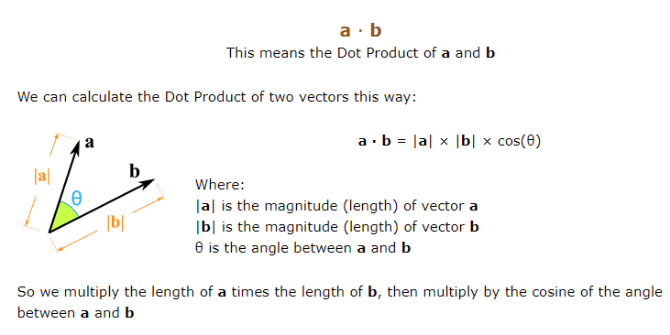
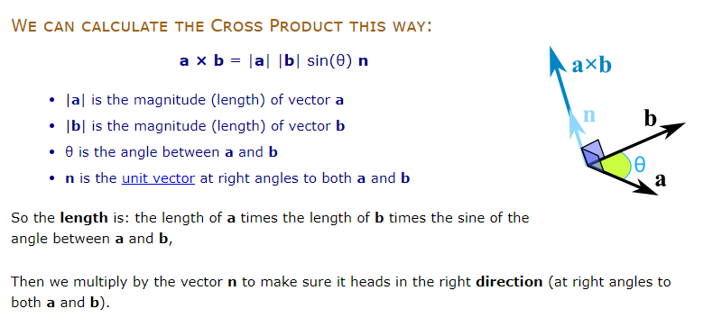
Cosine Distance
Defined as the cosine of the angle between two vectors.
Cosine distance = dot product of the vectors divided by the product of the lengths.
Th smaller the value the smaller the distance, ie, more similar.

Slide 22

Jaccard Coefficient
Compares the sum weight of shared terms to the sum weight of terms that are present in either of the two document but are not the shared terms.
Value ranges between 0 and 1, 1 when exactly same and 0 when no terms are common.
Another way to define Jaccard is
|Intersection (A,B)| / |Union (A,B)|

Slide 23
Levenshtein Distance
Also known as the edit distance.
Is the minimum number of single character edits (insertions, deletions or substitutions) required to change one sentence into another.

Slide 24
Hamming Distance
Between two strings of equal length is the number of positions at which the corresponding symbols are different.
ie, the minimum number of substitutions required to change one string into the other.
Or (or originally) the minimum number of errors that could have transformed one string into the other.

Slide 25
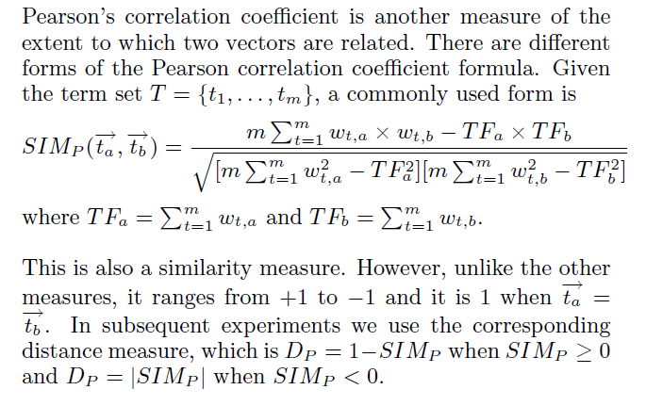
Pearson Correlation Coefficient

Slide 26
Demo Code TFIDF

